Slide 1
HELM: Setting the standard for biomolecular information exchange
CICAG – What would Dalton do now?
Claire Bellamy – HELM project manager
22nd June 2017
Notes:
Opening title slide

Slide 2
Contents
Why is biomolecular representation an issue?
What is HELM?
The HELM ecosystem
Key areas still to do

Slide 3
Why is biomolecular representation an issue?
And why talk about it here?

Slide 4
Why Now?
Best selling pharmaceuticals 2015
Rank | Drug | Trade name | Type | Main indications | Company | Sales (USD millions/year) | ∆ vs 2014
1 | Adalimumab | Humira | Biologic | Rheumatoid arthritis | AbbVie Inc. | 14,012 | 1,469
2 | Ledipasvir/sofosbuvir | Harvoni | Small molecule | Hepatitis C | Gilead Sciences | 13,864 | 11,737
3 | Etanercept | Enbrel | Biologic | Rheumatoid arthritis | Amgen Pfizer | 8,697 | 4,009
4 | Infliximab | Remicade | Biologic | Crohn's Disease Rheumatoid Arthritis | Johnson & Johnson | 8,355 | 1,487
5 | Rituximab | Mabthera Rituxan | Biologic | Lymphoma Leukemia Autoimmune disorders | Roche | 7,115 | 1,456
6 | Insulin glargine | Lantus | Biologic | Diabetes mellitus | Sanofi | 7,029 | 51
7 | Bevacizumab | Avastin | Biologic | Metastatic cancers | Roche | 6,751 | 270
8 | Trastuzumab | Herceptin | Biologic | Breast cancer | Roche | 6,603 | 265
9 | Lenalidomide | Revlimid | Small molecule | Multiple myeloma Myelodysplastic syndromes | Celgene | 5,801 | 821
10 | Sofosbuvir | Sovaldi | Small molecule | Hepatitis C | Gilead Sciences | 5,276 | (5,007
Source Wikipedia
Notes:
More than twice as much revenue from the biologics as the small molecules

Slide 5
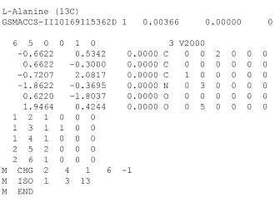
So what is the problem?
Small molecule representation is well understood and has been used for many years.
Although there are still areas to talk about the fundamentals are established.
  Most compounds pharma can generally be handled
Biologics is a long way behind.
  Many important substances cannot be represented fully with current tools
O=C(O)[C@@H](N)C
InChI=1S/C3H7NO2/c1-2(4)3(5)6/h2H,4H2,1H3,(H,5,6)/t2-/m1/s1
Key: QNAYBMKLOCPYGJ-UWTATZPHSA-N

Slide 6

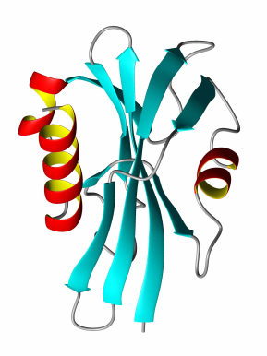

Biomolecules - Stuck in the middle…
GAP
Small Molecule Tools
Sequence-Based Tools
Small Molecules
Sequence
information
Biomolecules

Slide 7
Mipomersen
An Ionis product used to treat homozygous familial hypercholesterolemia.
The structure can be described as:
  G*-C*-C*-U*-C*-dA-dG-dT-dC-dT-dG-dmC-dT-dT-dmC-G*-C*-A*-C*-C*
  d = 2'-deoxy
  * = 2'-O-(2-methoxyethyl)
  with phosphorothioate linkages.
This is easy to read
But relies on a secondary explanation to capture all the information
A simple sequence is too limited

Slide 8
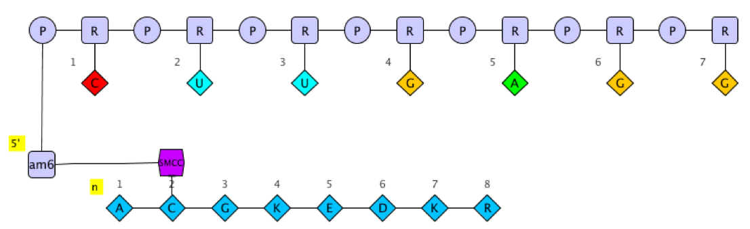
Hierarchical Editing Language for Macromolecules
Hierarchical
  Biomolecules are “multi-level polymers”
Complex Polymer
Simple Polymer
Monomer
Atom

Slide 9
Hierarchical Editing Language for Macromolecules
Hierarchical
  Biomolecules are “multi-level polymers”
Complex Polymer
Simple Polymer
Monomer
Atom

Slide 10
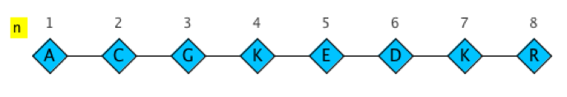
Hierarchical Editing Language for Macromolecules
Hierarchical
  Biomolecules are “multi-level polymers”
Complex Polymer
Simple Polymer
Monomer
Atom

Slide 11
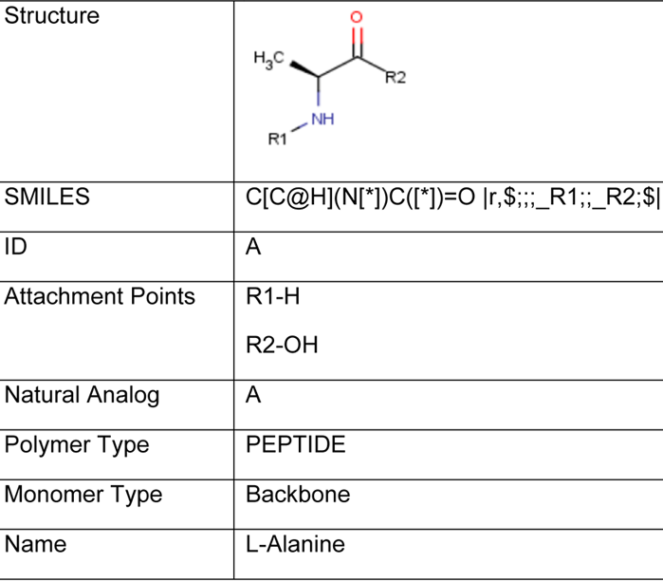

Hierarchical Editing Language for Macromolecules
Hierarchical
  Biomolecules are “multi-level polymers”
Complex Polymer
Simple Polymer
Monomer
Atom

Slide 12
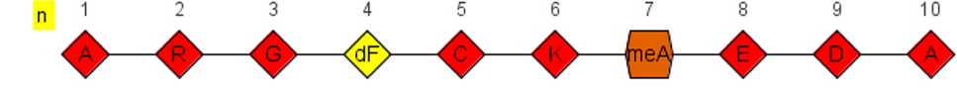
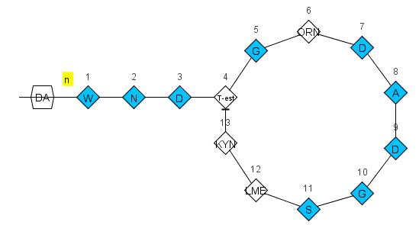
Notation format
ListOfSimplePolymers$ListOfConnections$ListOfPolymerGroups$ExtendedAnnotation$
HELM notation: PEPTIDE1{A.R.G.[dF].C.K.[meA].E.D.A}$$$$
Daptomycin
PEPTIDE1{W.N.D.[T-est].G.[OR].D.A.D.G.S.[LM].[KYN]}|CHEM1{DA}$
PEPTIDE1,PEPTIDE1,13:R2-4:R3|PEPTIDE1,CHEM1,1:R1-1:R1$$$

Slide 13
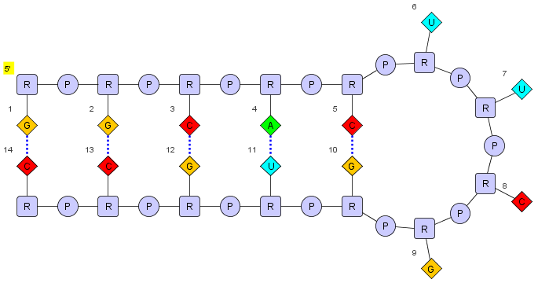
More examples
ListOfSimplePolymers$ListOfConnections$ListOfPolymerGroups$ExtendedAnnotation$
HELM notation
RNA1{R(G)P.R(G)P.R(C)P.R(A)P.R(C)P.R(U)P.R(U)P.R(C)P.R(G)P.R(G)P.R(U)P.R(G)P.R(C)P.R(C)}$$RNA1,RNA1,11:pair-32:pair|RNA1,RNA1,5:pair-38:pair|RNA1,RNA1,14:pair-29:pair|RNA1,RNA1,8:pair-35:pair|RNA1,RNA1,2:pair-41:pair$$

Slide 14
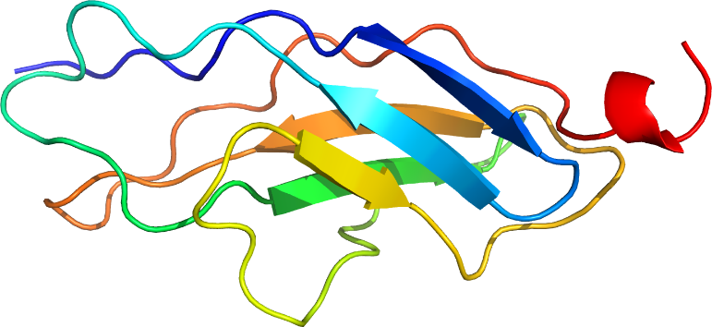
HELM…
…and very large molecules
Example: Connectin (Titin)
Human muscle protein out of 34,350 amino acids
=> 540,000 atoms
Creation and validation of HELM notation from FASTA in < 1 s
…and exchanging information
HELM relies on the monomer definitions
Monomer information can be exchanged using xHELM, an XML file format that includes the monomers for the molecules in the file.
… and monomer bloat
In-line HELM allows the definition of ‘temporary’ monomers when you with only use a monomer once.

Slide 15
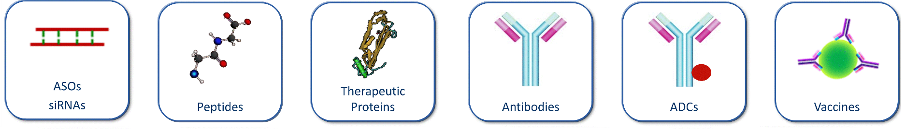
So… mission completed?
?
?
?
?
?
?
Unknown numbers of repeating elements
Various connection points of ADCs
Unknown elements in sequences
Unknown connections between polymers
Undefined polymers
...
Ambiguity is not something we handle well in either small or large molecule representation.

Slide 16
Monomer Ambiguity
* | 0..n unknown monomers | PEPTIDE1{A.*.G.C}$$$$V2.0
X | Single unknown amino acid in a PEPTIDE | PEPTIDE1{A.X.G.C}$$$$V2.0
N | Single unknown base in a RNA | RNA1{R(A)P.R(N)P.R(C)P.R(C)P.R(C)}$$$$V2.0
( , ) | One of a list of monomer is possible | PEPTIDE1{A.(A:10,G:90).G.C}$$$$V2.0
( + ) | Mixture of monomers | PEPTIDE1{A.(A+G+C).G.C}$$$$V2.0
_ | Deleted or missing single monomer | PEPTIDE1{A.(A,_).G.C}$$$$V2.0
´ ´ | Repeating monomers | PEPTIDE1{A.G.A.C.A‘5-30‘}$$$$V2.0
?
A
G
C

Slide 17
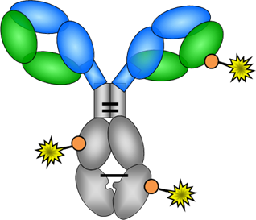
Other Ambiguity Types
Sequence or polymer type is unknown
BLOB1{Bead}”Aminated Polystyrene”|PEPTIDE1{A.G.T}$$$$
A
G
T
Connections are unknown

Slide 18
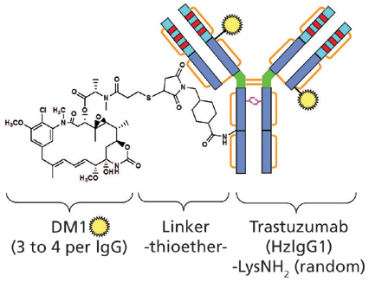
Ambiguity - Kadcyla
The connection between the drug and antibody is not well understood (Marcoux et al. 2015). Lysine-linked, but where?
Each trastuzumab molecule may be linked to zero to eight DM1 molecules (3.5 on average)
Glycosylation is present and not well understood

Slide 19
HELM notation - Kadcyla
PEPTIDE1{D.I.Q.M.T.Q.S.P.S.S.L.S.A.S.V.G.D.R.V.T.I.T.C.R.A.S.Q.D.V.N.T.A.V.A.W.Y.Q.Q.K.P.G.K.A.P.K.L.L.I.Y.S.A.S.F.L.Y.S.G.V.P.S.R.F.S.G.S.R.S.G.T.D.F.T.L.T.I.S.S.L.Q.P.E.D.F.A.T.Y.Y.C.Q.Q.H.Y.T.T.P.P.T.F.G.Q.G.T.K.V.E.I.K.R.T.V.A.A.P.S.V.F.I.F.P.P.S.D.E.Q.L.K.S.G.T.A.S.V.V.C.L.L.N.N.F.Y.P.R.E.A.K.V.Q.W.K.V.D.N.A.L.Q.S.G.N.S.Q.E.S.V.T.E.Q.D.S.K.D.S.T.Y.S.L.S.S.T.L.T.L.S.K.A.D.Y.E.K.H.K.V.Y.A.C.E.V.T.H.Q.G.L.S.S.P.V.T.K.S.F.N.R.G.E.C}|PEPTIDE2{E.V.Q.L.V.E.S.G.G.G.L.V.Q.P.G.G.S.L.R.L.S.C.A.A.S.G.F.N.I.K.D.T.Y.I.H.W.V.R.Q.A.P.G.K.G.L.E.W.V.A.R.I.Y.P.T.N.G.Y.T.R.Y.A.D.S.V.K.G.R.F.T.I.S.A.D.T.S.K.N.T.A.Y.L.Q.M.N.S.L.R.A.E.D.T.A.V.Y.Y.C.S.R.W.G.G.D.G.F.Y.A.M.D.Y.W.G.Q.G.T.L.V.T.V.S.S.A.S.T.K.G.P.S.V.F.P.L.A.P.S.S.K.S.T.S.G.G.T.A.A.L.G.C.L.V.K.D.Y.F.P.E.P.V.T.V.S.W.N.S.G.A.L.T.S.G.V.H.T.F.P.A.V.L.Q.S.S.G.L.Y.S.L.S.S.V.V.T.V.P.S.S.S.L.G.T.Q.T.Y.I.C.N.V.N.H.K.P.S.N.T.K.V.D.K.K.V.E.P.P.K.S.C.D.K.T.H.T.C.P.P.C.P.A.P.E.L.L.G.G.P.S.V.F.L.F.P.P.K.P.K.D.T.L.M.I.S.R.T.P.E.V.T.C.V.V.V.D.V.S.H.E.D.P.E.V.K.F.N.W.Y.V.D.G.V.E.V.H.N.A.K.T.K.P.R.E.E.Q.Y.N.S.T.Y.R.V.V.S.V.L.T.V.L.H.Q.D.W.L.N.G.K.E.Y.K.C.K.V.S.N.K.A.L.P.A.P.I.E.K.T.I.S.K.A.K.G.Q.P.R.E.P.Q.V.Y.T.L.P.P.S.R.D.E.L.T.K.N.Q.V.S.L.T.C.L.V.K.G.F.Y.P.S.D.I.A.V.E.W.E.S.N.G.Q.P.E.N.N.Y.K.T.T.P.P.V.L.D.S.D.G.S.F.F.L.Y.S.K.L.T.V.D.K.S.R.W.Q.Q.G.N.V.F.S.C.S.V.M.H.E.A.L.H.N.H.Y.T.Q.K.S.L.S.L.S.P.G.K}|PEPTIDE3{E.V.Q.L.V.E.S.G.G.G.L.V.Q.P.G.G.S.L.R.L.S.C.A.A.S.G.F.N.I.K.D.T.Y.I.H.W.V.R.Q.A.P.G.K.G.L.E.W.V.A.R.I.Y.P.T.N.G.Y.T.R.Y.A.D.S.V.K.G.R.F.T.I.S.A.D.T.S.K.N.T.A.Y.L.Q.M.N.S.L.R.A.E.D.T.A.V.Y.Y.C.S.R.W.G.G.D.G.F.Y.A.M.D.Y.W.G.Q.G.T.L.V.T.V.S.S.A.S.T.K.G.P.S.V.F.P.L.A.P.S.S.K.S.T.S.G.G.T.A.A.L.G.C.L.V.K.D.Y.F.P.E.P.V.T.V.S.W.N.S.G.A.L.T.S.G.V.H.T.F.P.A.V.L.Q.S.S.G.L.Y.S.L.S.S.V.V.T.V.P.S.S.S.L.G.T.Q.T.Y.I.C.N.V.N.H.K.P.S.N.T.K.V.D.K.K.V.E.P.P.K.S.C.D.K.T.H.T.C.P.P.C.P.A.P.E.L.L.G.G.P.S.V.F.L.F.P.P.K.P.K.D.T.L.M.I.S.R.T.P.E.V.T.C.V.V.V.D.V.S.H.E.D.P.E.V.K.F.N.W.Y.V.D.G.V.E.V.H.N.A.K.T.K.P.R.E.E.Q.Y.N.S.T.Y.R.V.V.S.V.L.T.V.L.H.Q.D.W.L.N.G.K.E.Y.K.C.K.V.S.N.K.A.L.P.A.P.I.E.K.T.I.S.K.A.K.G.Q.P.R.E.P.Q.V.Y.T.L.P.P.S.R.D.E.L.T.K.N.Q.V.S.L.T.C.L.V.K.G.F.Y.P.S.D.I.A.V.E.W.E.S.N.G.Q.P.E.N.N.Y.K.T.T.P.P.V.L.D.S.D.G.S.F.F.L.Y.S.K.L.T.V.D.K.S.R.W.Q.Q.G.N.V.F.S.C.S.V.M.H.E.A.L.H.N.H.Y.T.Q.K.S.L.S.L.S.P.G.K}|PEPTIDE4{D.I.Q.M.T.Q.S.P.S.S.L.S.A.S.V.G.D.R.V.T.I.T.C.R.A.S.Q.D.V.N.T.A.V.A.W.Y.Q.Q.K.P.G.K.A.P.K.L.L.I.Y.S.A.S.F.L.Y.S.G.V.P.S.R.F.S.G.S.R.S.G.T.D.F.T.L.T.I.S.S.L.Q.P.E.D.F.A.T.Y.Y.C.Q.Q.H.Y.T.T.P.P.T.F.G.Q.G.T.K.V.E.I.K.R.T.V.A.A.P.S.V.F.I.F.P.P.S.D.E.Q.L.K.S.G.T.A.S.V.V.C.L.L.N.N.F.Y.P.R.E.A.K.V.Q.W.K.V.D.N.A.L.Q.S.G.N.S.Q.E.S.V.T.E.Q.D.S.K.D.S.T.Y.S.L.S.S.T.L.T.L.S.K.A.D.Y.E.K.H.K.V.Y.A.C.E.V.T.H.Q.G.L.S.S.P.V.T.K.S.F.N.R.G.E.C}|CHEM1{[SMCC]}|CHEM2{[DM1]}$CHEM1,CHEM2,1:R2-1:R1|PEPTIDE1,PEPTIDE1,23:R3-88:R3|PEPTIDE2,PEPTIDE2,371:R3-429:R3|PEPTIDE4,PEPTIDE4,134:R3-194:R3|PEPTIDE1,PEPTIDE1,134:R3-194:R3|PEPTIDE3,PEPTIDE3,265:R3-325:R3|PEPTIDE3,PEPTIDE4,224:R3-214:R3|PEPTIDE2,PEPTIDE3,233:R3-233:R3|PEPTIDE2,PEPTIDE2,265:R3-325:R3|PEPTIDE2,PEPTIDE2,147:R3-203:R3|PEPTIDE2,PEPTIDE3,230:R3-230:R3|PEPTIDE2,PEPTIDE1,224:R3-214:R3|PEPTIDE3,PEPTIDE3,147:R3-203:R3|PEPTIDE2,PEPTIDE2,22:R3-96:R3|PEPTIDE3,PEPTIDE3,22:R3-96:R3|PEPTIDE3,PEPTIDE3,371:R3-429:R3|PEPTIDE4,PEPTIDE4,23:R3-88:R3|
G1,CHEM1,K:R3-1:R1$G1(PEPTIDE1+PEPTIDE2+PEPTIDE3+PEPTIDE4)|G2(CHEM1:3.5+G1:1)$$V2.0
Connected to a lysine, but could be any in the group
3.5:1 ratio of SMCC to antibody

Slide 20
HELM in practice

Slide 21
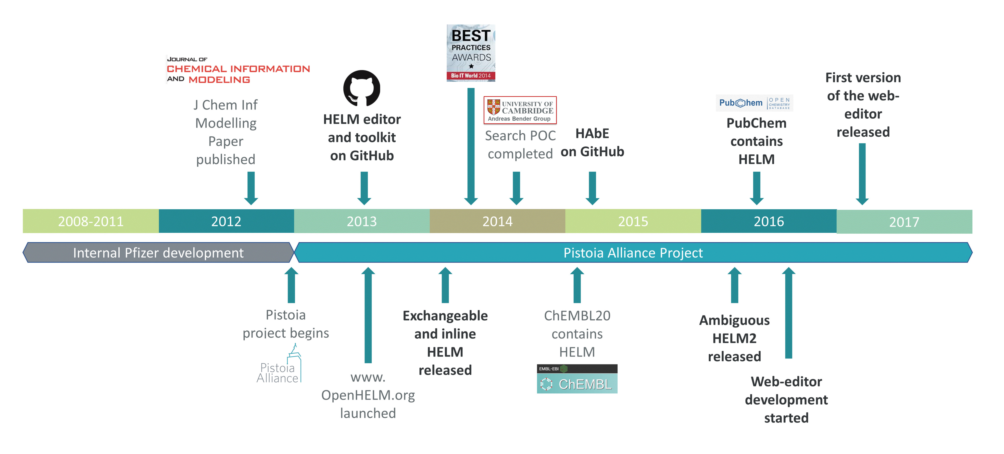
HELM Project

Slide 22
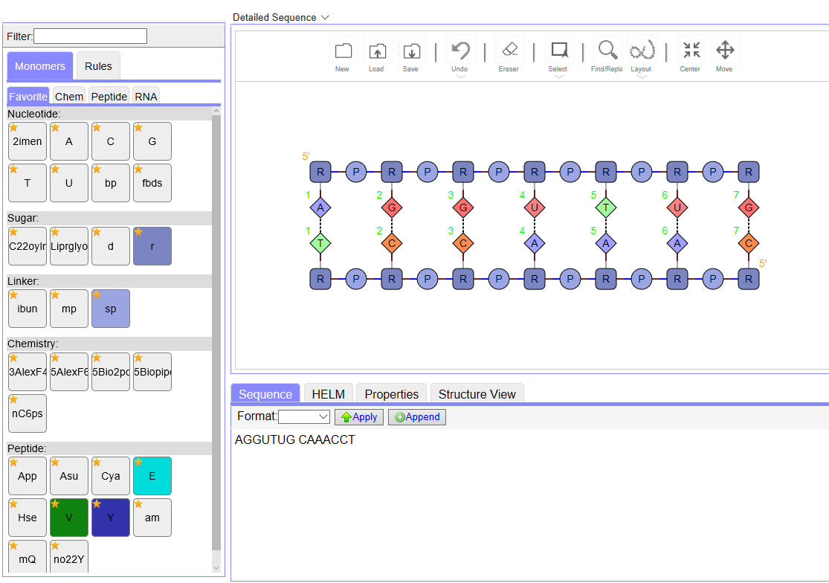
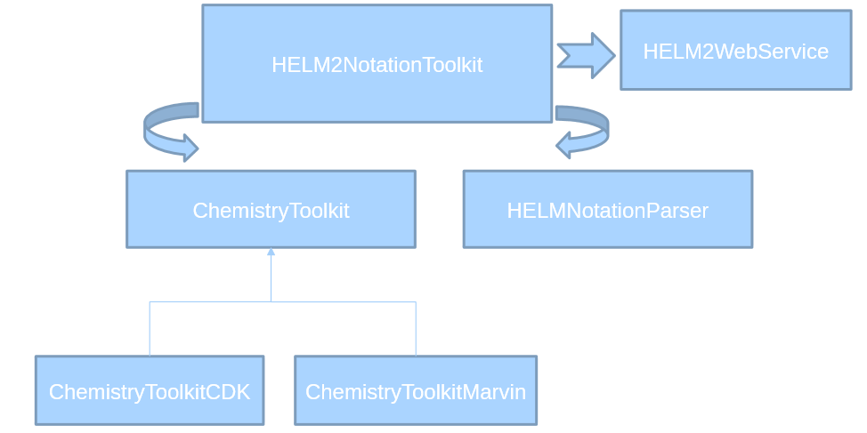
HELM Open Source Tools
Web-based editor – currently HELM1.
We are working on HELM2 and expect
to publish later this year.
HELM2 is implemented in the toolkit
And can be accessed via RESTFUL
web-services

Slide 23
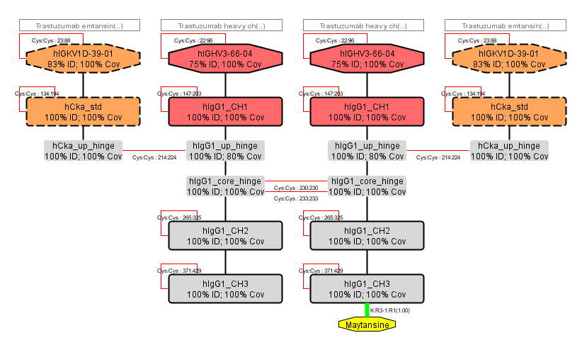
HELM Antibody Editor (HAbE)
HAbE (developed by Roche), will take in an antibody sequence, run a BLAST search and identify and display domains.
The initial domain assignment can be edited if the scientist believes it is incorrect and the editor can be used to adjust Cys-cys bonds and any other structural element.

Slide 24

The HELM Ecosystem
Pharma / Biotech
  BMS, GSK, Ionis, Merck, Novartis, Pfizer, Roche
Software vendors
  ACD/Labs, BioMax, BIOVIA, ChemAxon, NextMove, PerkinElmer, Scilligence
Content / Service Providers
  EBI (ChEMBL), NCBI (PubChem), quattro research
Regulatory
  Acceptable format in ISO 11238 guidelines

Slide 25
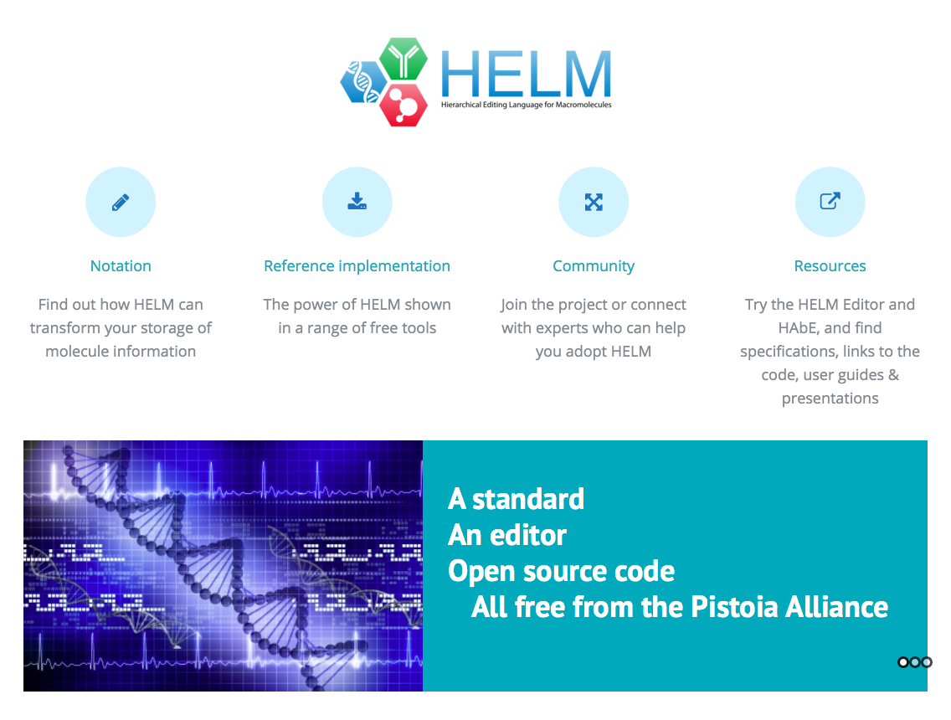


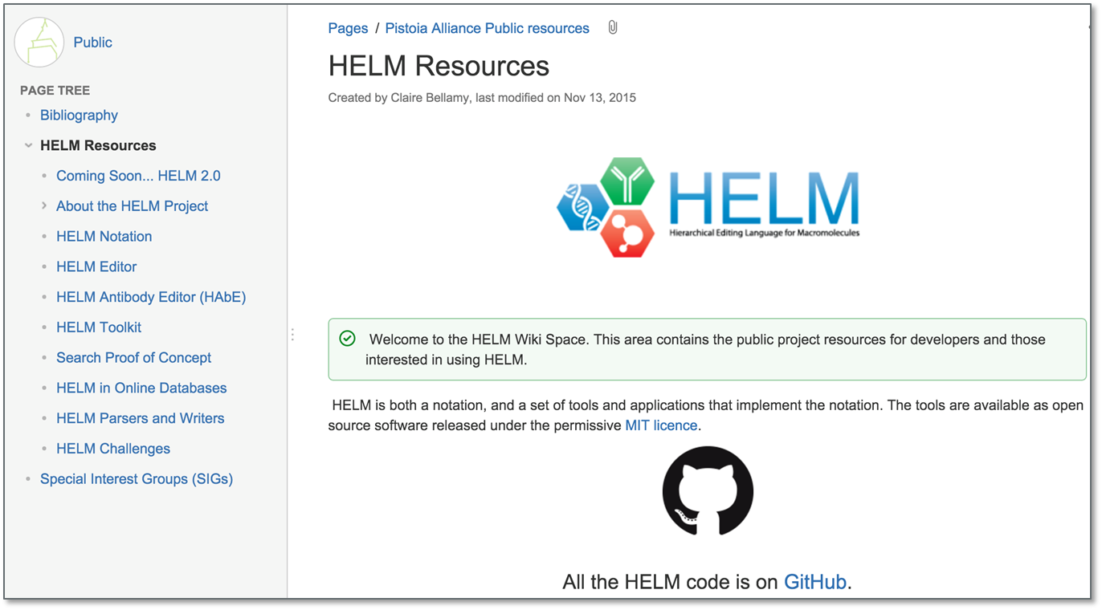
On-line information
www.OpenHelm.org
https://github.com/PistoiaHELM
Permissive MIT license
Wiki contains
Specifications
User guides
Presentations
Links to code

Slide 26
What would Dalton do next?

Slide 27
Monomer naming
Monomers are identified by convention.
Natural monomers are limited in number and observed in plants and animals.
Unnatural monomers, are whatever is convenient for synthetic biology.
HELM allows the user to define whatever monomer they like and enables organisations to exchange them, however consistency makes everyone’s life easier.
Existing nucleotide conventions
IUPAC rules on biochemical nomenclature, Abbreviations and Symbols for Nucleic Acids, Polynucleotides and their Constituents

Slide 28
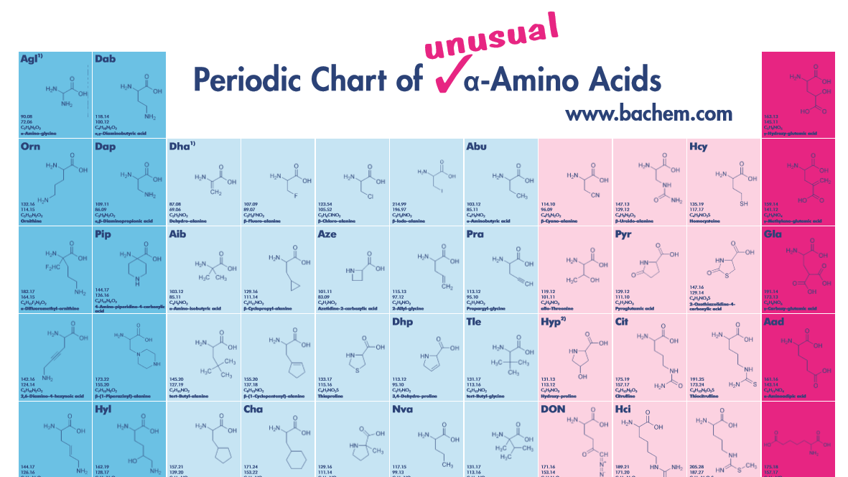
Monomer naming
Peptide monomers
IUPAC peptide and amino acid nomenclature
  Good for D, L amino acids, but does not give much guidance for anything more complex
INSDC
  has a nice table of amino acids and modified ones that use MeGly for N-methylglycine (consortium includes EMBL and GenBank)
Consistent naming conventions are in short supply.
In the absence of anything else – people will make stuff up.
Guidance from serious academic bodies would be helpful.

Slide 29
Ambiguity – a challenge
HELM has made a start, but we are only now building tools to use in ‘real-life’ and may find further areas to work on.
HELM2 can’t be converted into small molecule formats such as molfiles, SMILES and InChI as they can’t handle ambiguity.
InChI are interested in looking at ambiguity and the InChI positional isomers group could be a key enabler
Shameless plug – this group is looking for new members to help with this work

Slide 30
Acknowledgements
Leadership
Sergio Rotstein (Pfizer) – Project Lead
Claire Bellamy (Pistoia Alliance) – Project Manager
Active Team
Jan Holst Jensen (Chembiofusion)
Stefan Klostermann (Roche)
Roland Knispel (ChemAxon)
Jeff Milton (Ionis)
Sven Neumeyer (Novartis)
Matthias Nolte (BMS)
Yohann Potier (Novartis)
Joann Precott-Roy (Novartis)
Eric Swayze (Ionis)
Markus Weisser (quattro)
Tianhong Zhang (Pfizer)
Steering Committee
Margret Assfalg (Roche)
David Nirschl (BMS)
Ranjeeva Ramasinghe (GSK)
Sergio Rotstein (Pfizer)
Eric Swayze (Ionis)
John Wise (Pistoia Alliance)
Quan Yang (Novartis)
Pfizer Team
Peter Henstock
David Klatte
Christine Lawrence
Frank Loganzo
Hongli Li
Sergio Rotstein
Simone Sciabola
Rob Stanton
Nathan Tumey
Simon Xi
Tianhong Zhang

Slide 31


www.OpenHelm.org
info@openhelm.org

Slide 32
Thank you
Claire.Bellamy@pistoiaalliance.org

Slide 33
Backup slides

